Slide 1
Setting up H3 Internal scRNA-Seq Analysis
03.28.2022
Nathan T. Johnson

Slide 2
Outline
Brief scRNA-Seq Primer
Brief Pilot H3 scRNA-seq Primer
Problem Setup
SBG scRNA-Seq Infastructure Not Sufficient for ALL H3 Needs
Next Week SBG Will Provide scRNA-Seq Tutorial
Most Genomic scRNA-Seq Providers: BGI, Genewiz, MIT etc. will provide processed data as matrix file
Need Internal Ability to Process scRNA-Seq data

Slide 3
scRNA-Seq Analysis Background

Slide 4
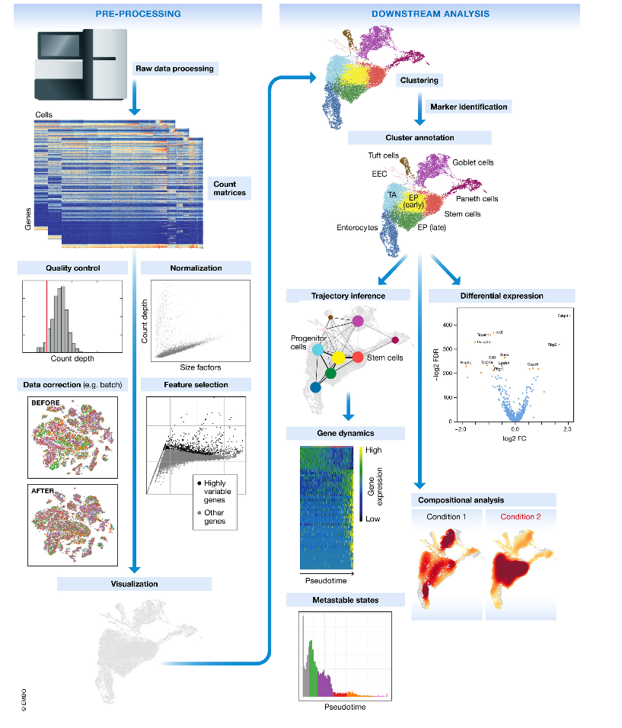
A Typical scRNA-Seq Analysis Workflow
Extensive Quality Control and pre-processing
Cluster the single cells
Identify single cell type
Explore the range of single cell states
Differential analysis between clusters, types, states
Compare the above between biological conditions
Luecken, Malte D., and Fabian J. Theis. "Current best practices in single‐cell RNA‐seq analysis: a tutorial." Molecular systems biology 15.6 (2019): e8746.

Slide 5
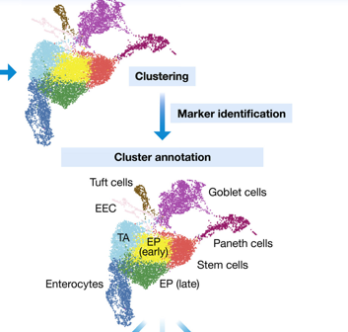
How to draw biologically meaningful insights from scRNASEQ
Identifying cell types or cell states of interest
Visualization of dimensionality reduction : PCA, tSNE, UMAP
Clustering : kmeans , graph-based, hierarchical
Marker gene detection: DEG analysis between clusters and doing pathway analysis
Trajectory inference: ordering cells along a pseudotime trajectory where pseudotime is calculated based on expression similarities of neighboring cells
Luecken, Malte D., and Fabian J. Theis. "Current best practices in single‐cell RNA‐seq analysis: a tutorial." Molecular systems biology 15.6 (2019): e8746.

Slide 7


scRNA-Seq SBG Workflow
Internal
Publicly Available Raw Sequencing Data
SBG Apps
Apps to build
SRA Download and Extract
I/O
Raw Sequencing Data
Compress Data
Apps Needing Editing
Reformat Files
Unused, but Available
Prepped Sequencing Data (fastq.gz)
Cell Ranger Targeted-Depth
Cell Ranger Count
Cell Ranger VDJ
Cell Ranger Aggregate
Cell Ranger Reanalyze
H3 S3 Bucket
Cell Ranger Targeted Compare
Cluster & Gene Marker Analysis
Cell Ranger Multi*
*Combines the above

Slide 8
Why Is SBG Not Suitable for Broad H3 Usage
What Works Well
Cell Ranger Processing
QC Filtering
What Does Not Work Well
Moving Files from each processed step
Requires manual editing to allow usage
Does Not Exist
Any Post Handling Processing such as Cell Type Calling, not existence
Impossible to work with publicly available data
To Be Automated / Improved
SBG: 362-562 hours = $90k - $133k to implement
H3 perspective: scRNA-Seq is so standard, SBG should bear the primary cost
Need Solution In Meantime

Slide 9
Possible Full H3 scRNA-Seq Analysis Deliverables
Brainstorming on H3 Fully Desired Deliverables:
QC assessment
Dimension Reduction
Normalization
Cluster Analysis
Cell Identity
Cell State
Comparisons of the above between biological states
Dashboard & Report representation
A Loupe data file for on your laptop visualization
Trajectory Analysis
Analyze publicly available scRNA-Seq data
Data output for extended analysis
Completed
Improvements Desired
Not Available in SBG

Slide 10
H3 Pilot scRNA-Seq Study Summary
Sample Preparation & Sequencing = Highly Variable Results

Slide 11
Study Workflow
Untreated
24 h
Mice implanted with CT26-HER2 tumors
Harvest tumor
Dissociation of tumor
Treated with HER2-STING ADC
CD45 enrichment
3 days
Sequence Via: BGI & MIT
FACS analysis
Thaw tumor cells
Freeze tumor cells

Slide 12
Basic MIT and BGI Quality Control Measure compare to 10K PBMC
 | Estimated # of Cells | Mean Reads Per Cell | Median Genes per Cell | Sequencing Saturation | Reads Mapped to Intergenic Regions | Mapped to Transcriptome
10X | 9,247 | 49,311 | 2,277 | 59.70% | NA | NA
BGI
Control | 20,574 | 49,018 | 3,794 | 32.60% | 3.10% | 73.80%
Condition | 8,171 | 82,000 | 3,441 | 55.70% | 3.60% | 71.20%
MIT
Control | 16,218 | 76,790 | 1,914 | 56.10% | 8.40% | 52.40%
Condition | 4,495 | 298,187 | 1,178 | 87.40% | 15.40% | 43.50%

Slide 13
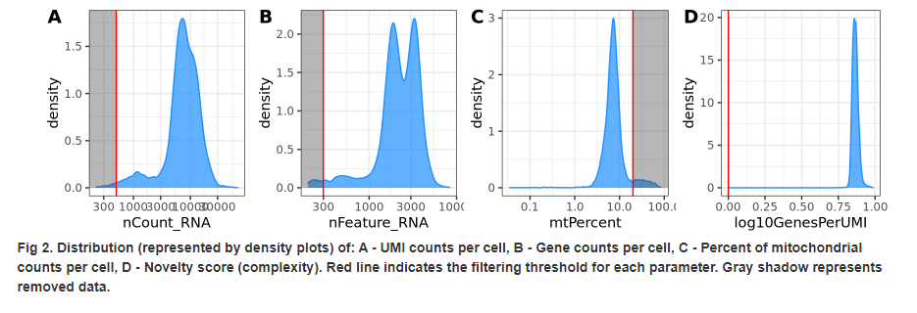
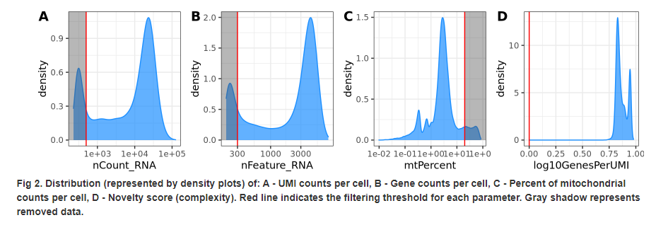
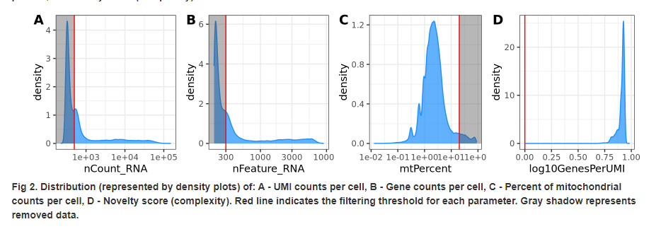
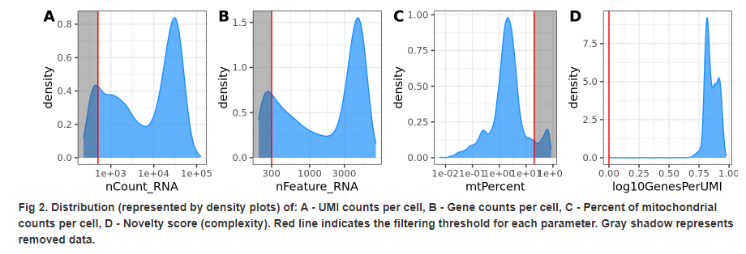
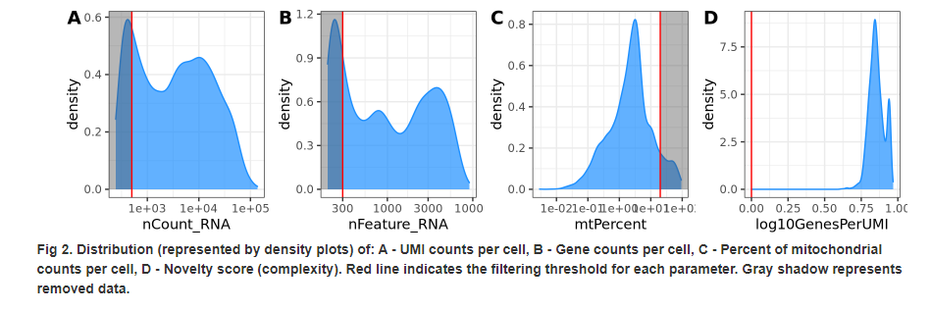
Distribution & Sampling Depth (Compared to ‘easy’ dataset)
10k PMBC Control Dataset
BGI
MIT
Control
Condition

Slide 14
Cell Type By Sample Percentage

Slide 15
BGI Percentage Pie Charts
Control
Condition

Slide 16
MIT Percentage Pie Charts
Control
Condition

Slide 17
A lot of Noise on Plot

Slide 18
Removing Fibroplasts and Epithelial Does Not Change

Slide 19
Lower Complexity

Slide 20
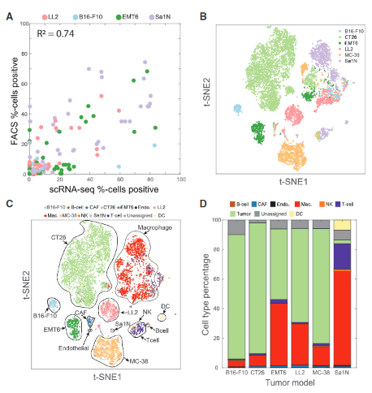
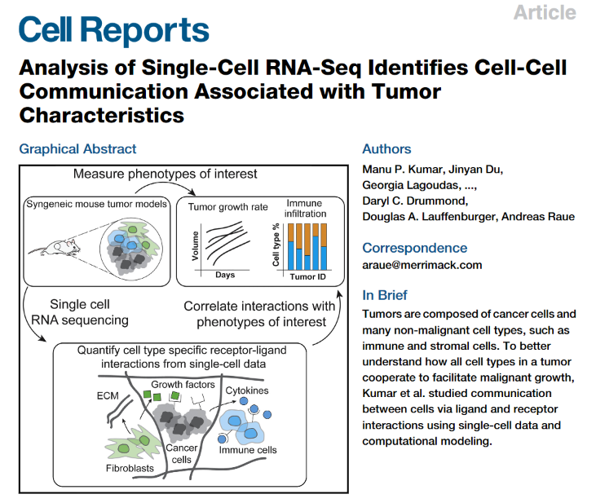
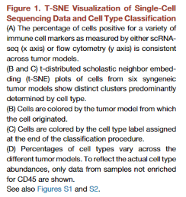
Next Steps: Biologist Question Analysis: Validate Process Using Public Data

Slide 21
Use AWS + Nextflow

Slide 22
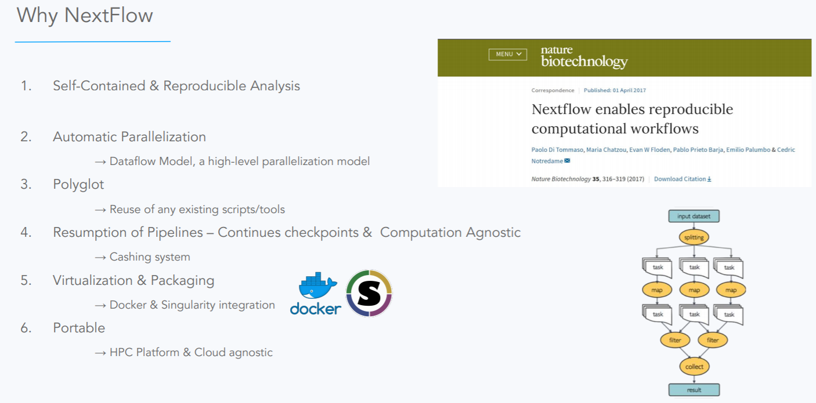
Solution: Use a Modern Workflow Manager: Nextflow

Slide 23
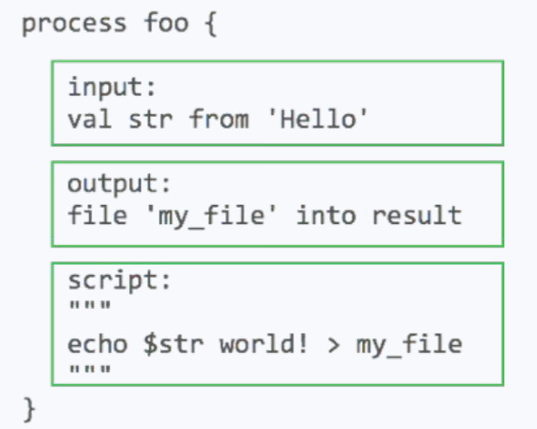
Simple Definitions
Define Inputs/Outputs
What should be run on the command line
Implies: not restrictive by programming language
Modular setup
Follow up from last weeks discussion
Workflow should be modular so that processes can be swapped

Slide 24
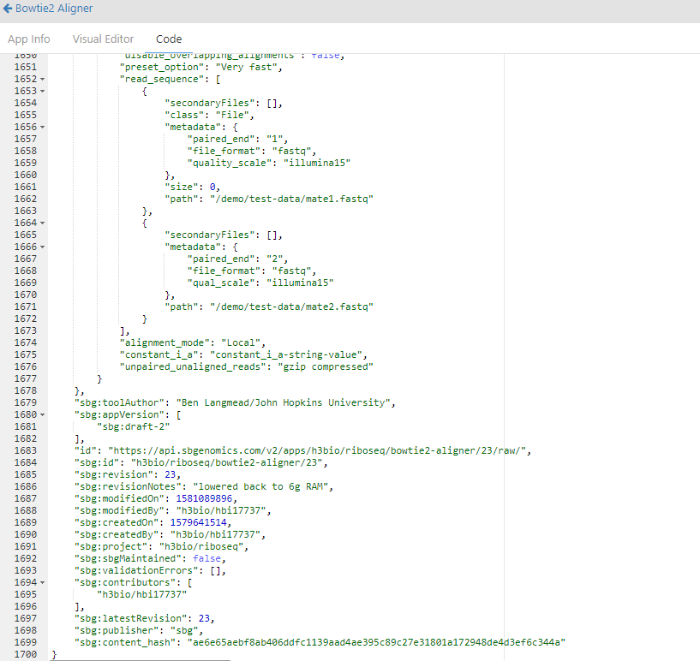
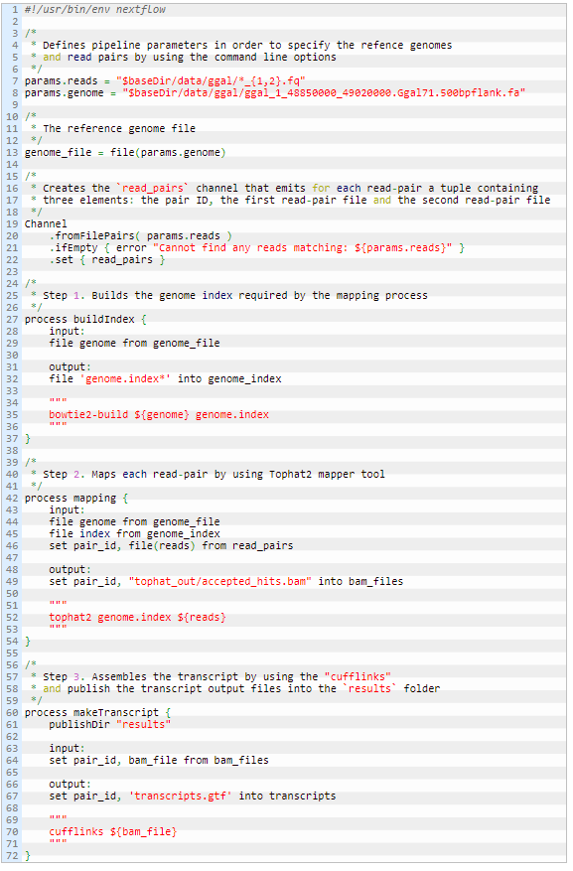
Code Complexity: SBG vs Nextflow
SBG
RNASeq Nextflow Pipeline
Define Reference Files
Builds Index File
Only Defining Aligner
Map Reads
Quantify Transcripts
*This is why I would propose time for implementation is longer then expected for SBG

Slide 25
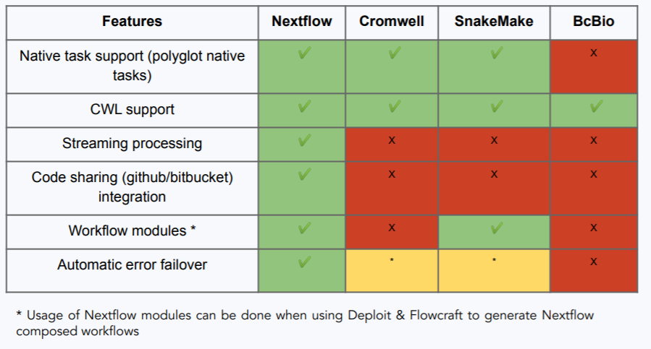
Pipeline Manager Comparison
Bcbio: Harvard Chan School Pipeline manager
Snakemake: Python pipeline manager
Cromwell: Broad’s pipeline manager (most similar to SBG)

Slide 26
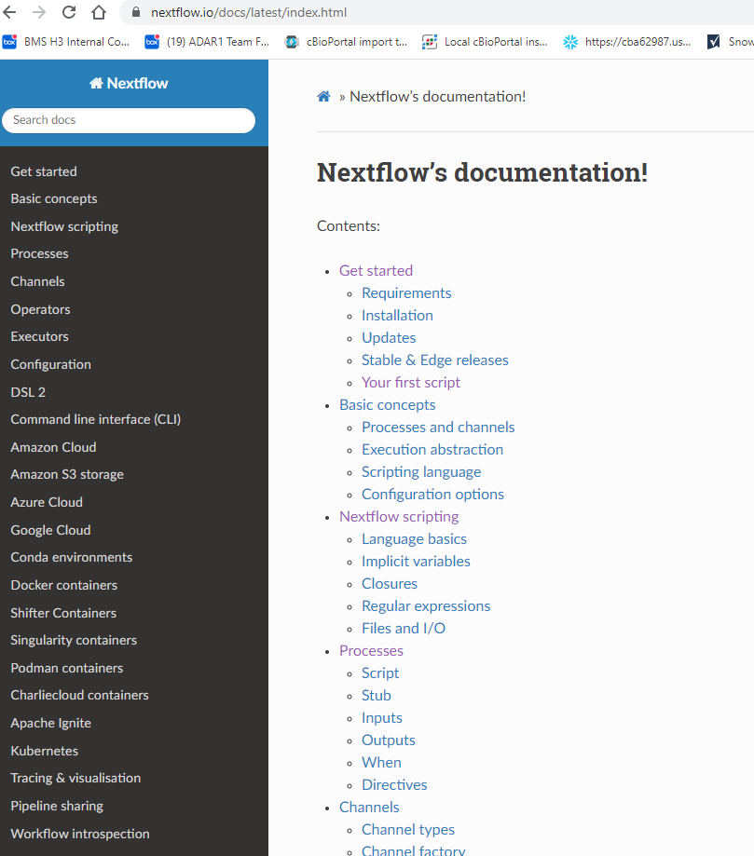
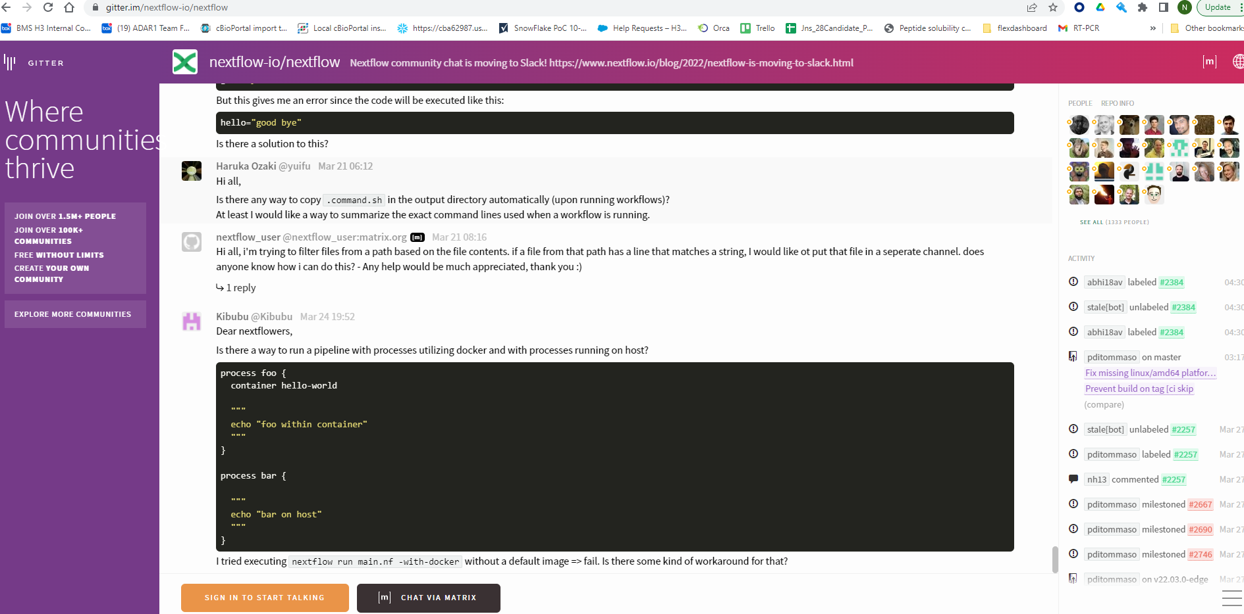

Nextflow Well Documented & Supported

Slide 27
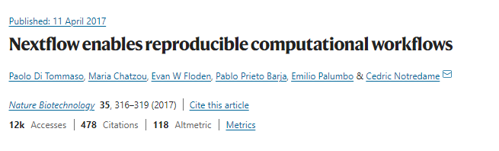

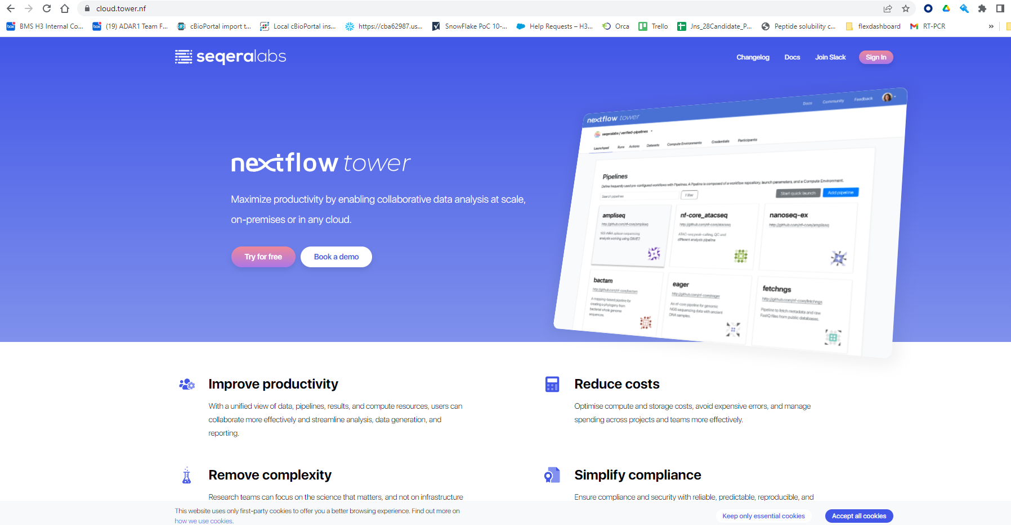




SBG Like Companies Built On Top Of Nextflow
Will / Is Rivaling SBG & DNA Nexus
Primary Author: Poor Business Model

Slide 28
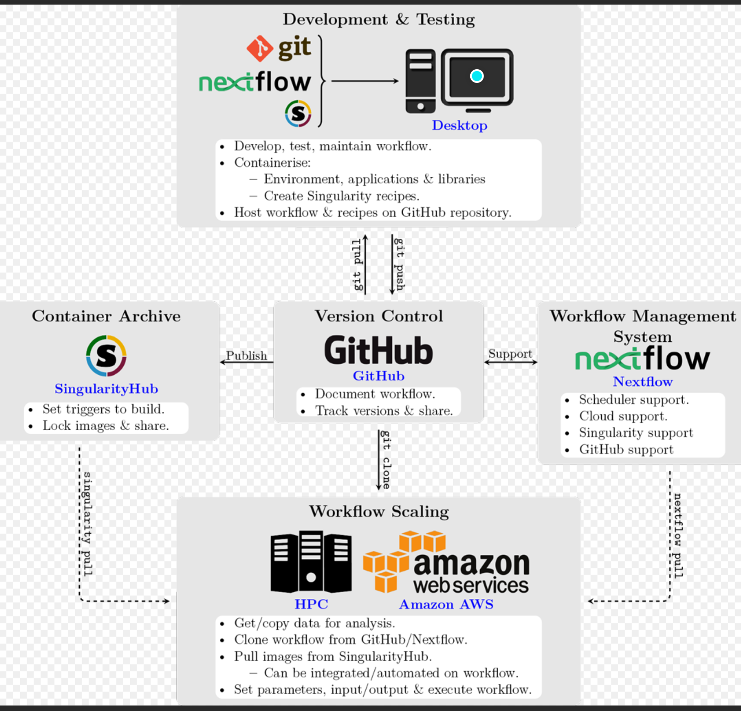
Ideal Setup
*Amazon’s Genomic Pipeline Requires Nextflow implementation
At least 2 Boston Based Consultant Groups Could be Contracted to Build Out (Possibly Maintain) Pipelines:
Diamond Age
Bridge Informatics

Slide 29
H3 Implementing scRNA-Seq Internal Analysis Capabilities

Slide 30
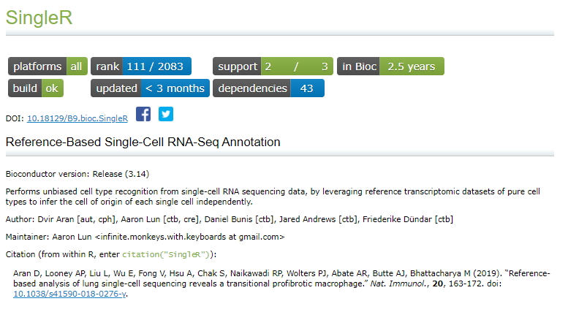
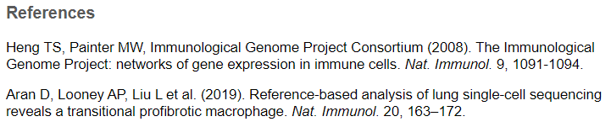
Full H3 Nextflow Pipeline
Purpose: Be able to work with publicly available scRNA-Seq data / Process / Analyze
Modular
SRA Processing (Bash)
Cell Ranger (Bash)
Cell Type Calling (R)
QC Cleanup (R)
SRA Download & Processing
(pulls lifebit/kallisto-sra docker image)
CellRanger (local install of CellRanger)
QC Filter (local renv install)
CellType Calling (local renv install)
Implemented Cell Type Caller: SingleR
Reference Database: ImmGenData (830 microarray samples of pure mouse immune cells)

Slide 31
scRNA-Seq Implementation
Phase 1: Demonstrate Nextflow Proof Of Concept (Done)
Input: Cell Ranger Output
Output: Cell Type Calling & QC Cleanup
Phase 2: Implement Nextflow Public Data Processing Proof of Concept (Done)
Input: SRA Project ID (External Datasets)
Output: Data Ready for Cell Ranger Ingestion
Phase 3: Full Pipeline Modular Run on Public Dataset (Done)
Phase 4: Full Pipeline Run on Public Dataset (In Progress)
Phase 5: Implement AWS Batch Infrastructure (In Progress)
AWS Instance + AMI (Currently 1 AWS Instance)
Docker
Phase 6: H3 Training / Documentation / Version Control (In Progress)

Slide 32
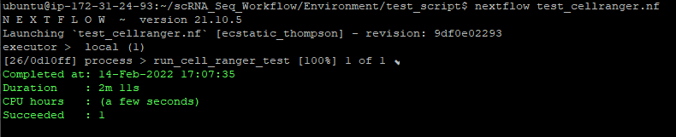
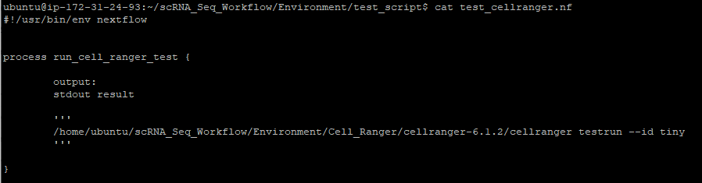
Nextflow-Cell Ranger Simple Concept
Steps:
Install Cell Ranger
Write simple one line bash script to run cell ranger
Write Nextflow Process to run Bash Script
Test by running bashscript & cellranger command

Slide 33
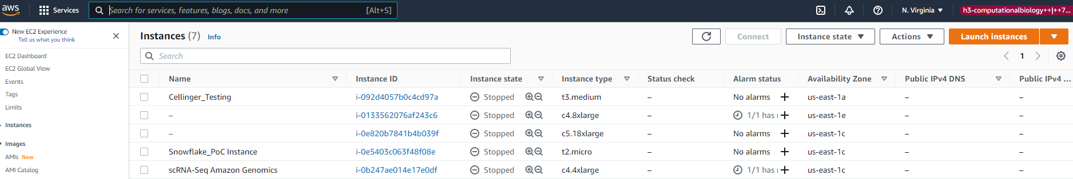
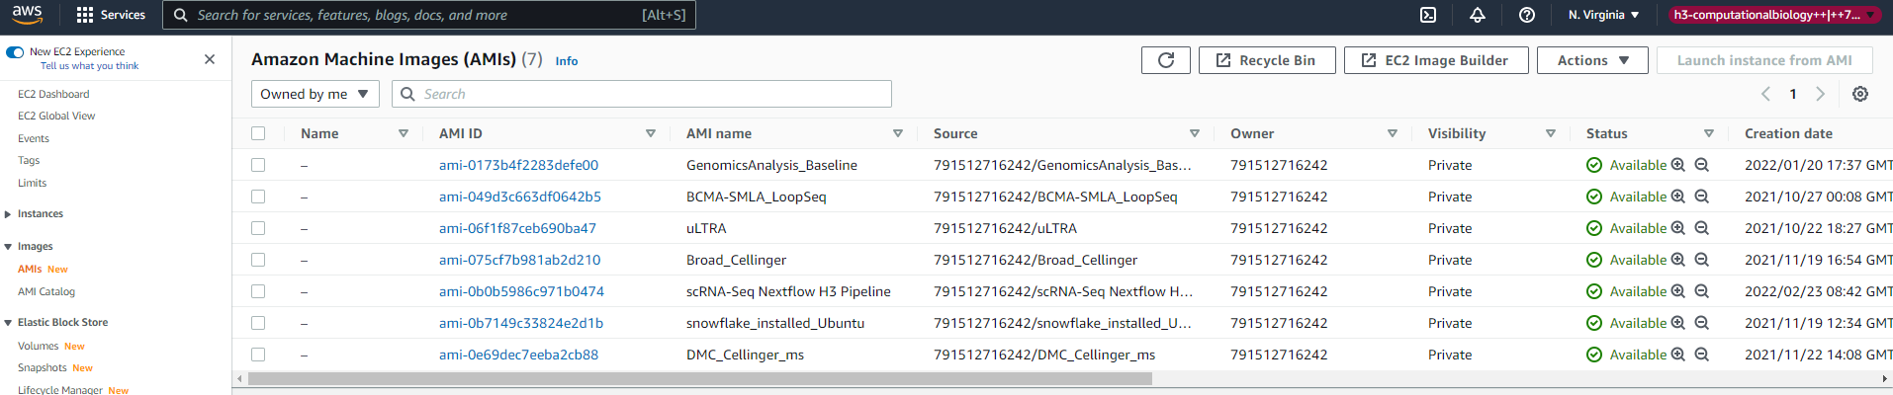
EC2 Instance & AMI

Slide 34
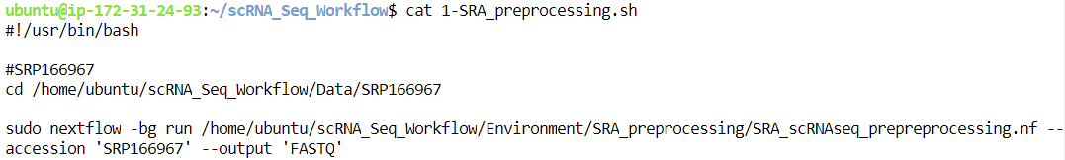
Nextflow-Full SRA Processing Pipeline Initiating
Initiating Pipeline

Slide 35
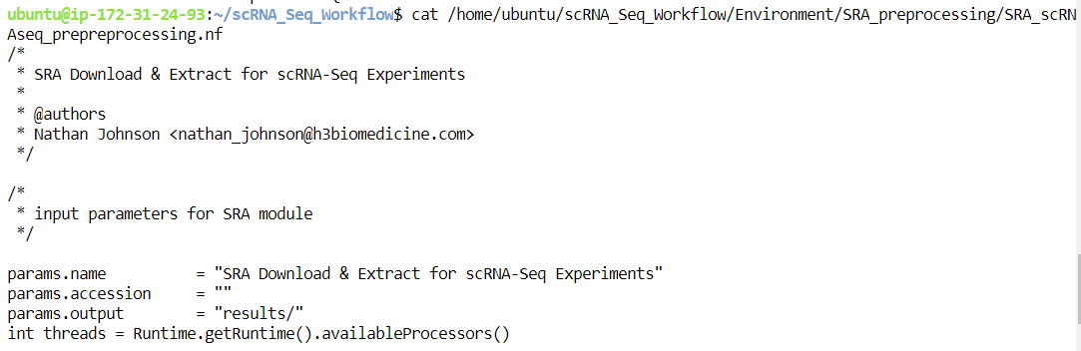
Nextflow-Full SRA Processing Structure: Parameters

Slide 36
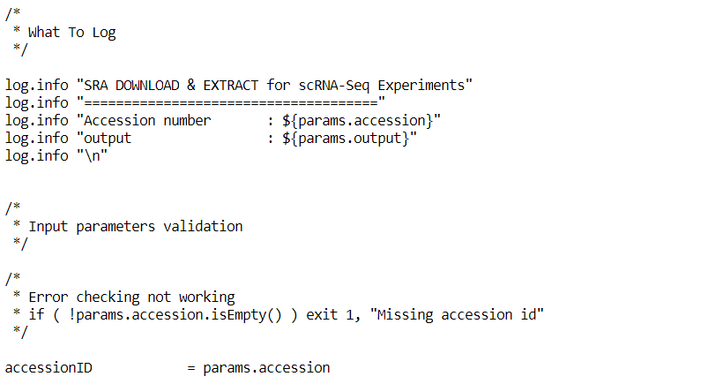
Nextflow-Full SRA Processing Structure: Logging & Simple Error Checking

Slide 37
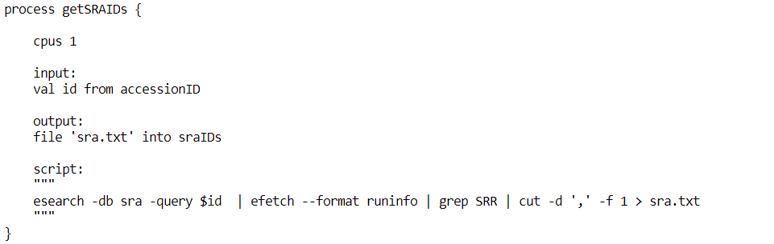
Nextflow-Full SRA Processing Structure: Get SRA IDs

Slide 38
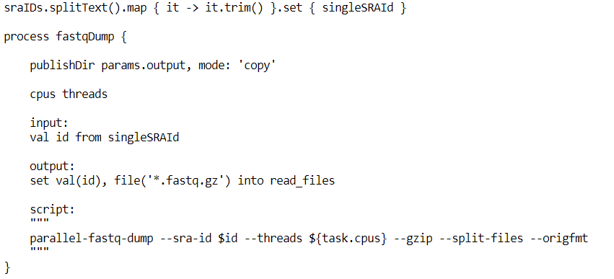
Nextflow-Full SRA Processing Structure: Download & Extract

Slide 39
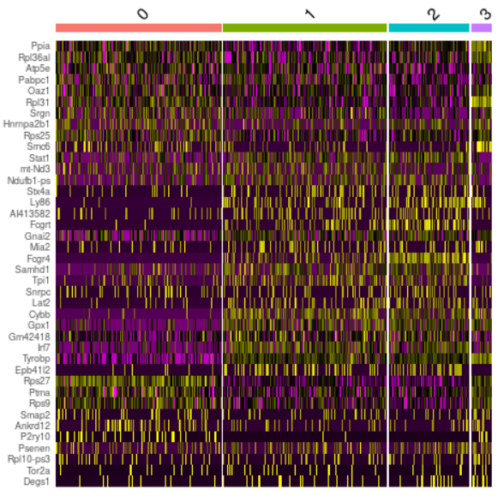
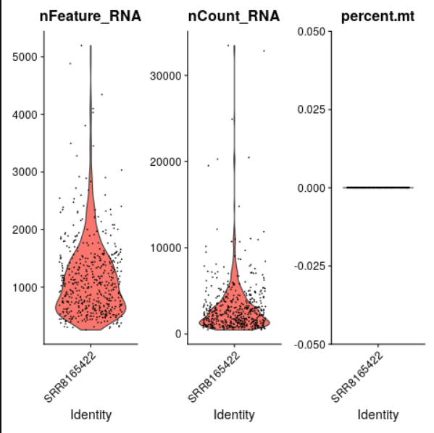
Quality Control Plot Example

Slide 40
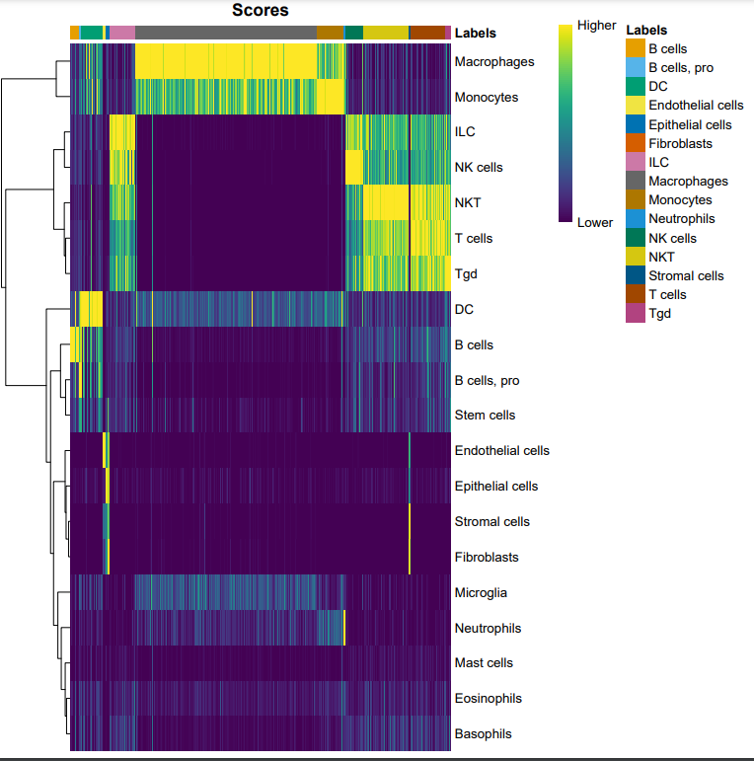
Cell Type Calling Plot Examples

Slide 41
Conclusions / Next Steps
H3 Has Internal scRNA-Seq Capabilities
Improvements / Documentation In Progress So Anyone At H3 Can Run
Training Late April / Early May
On NextFlow
Use Cases: H3 Internal Pipelines
scRNA-Seq
Splicing Analysis

Slide 42
Backup

Slide 43
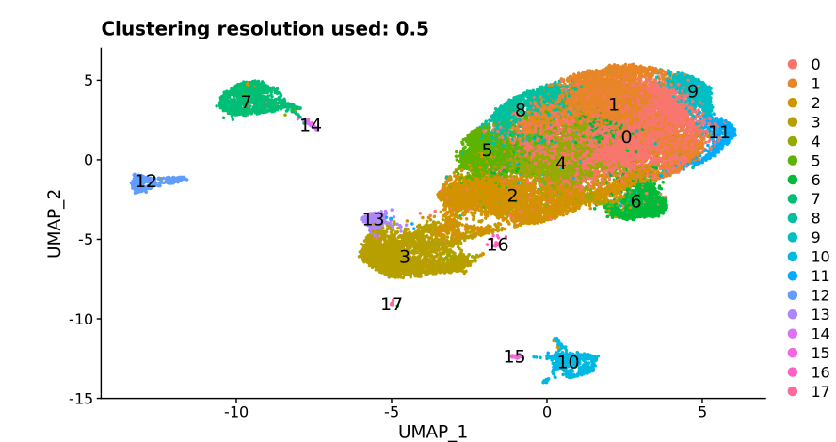
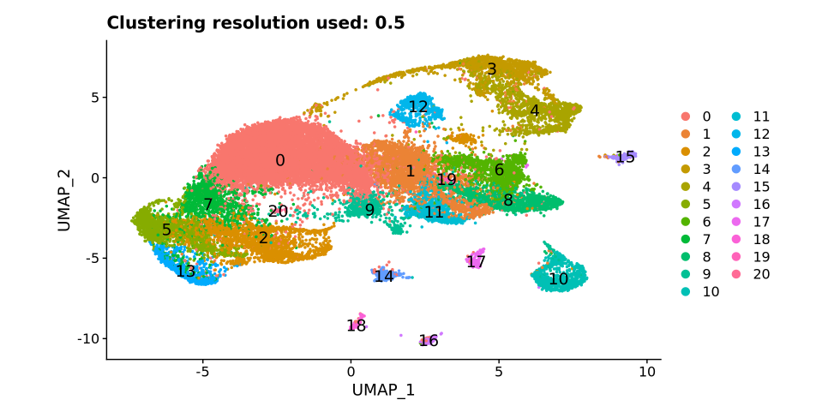
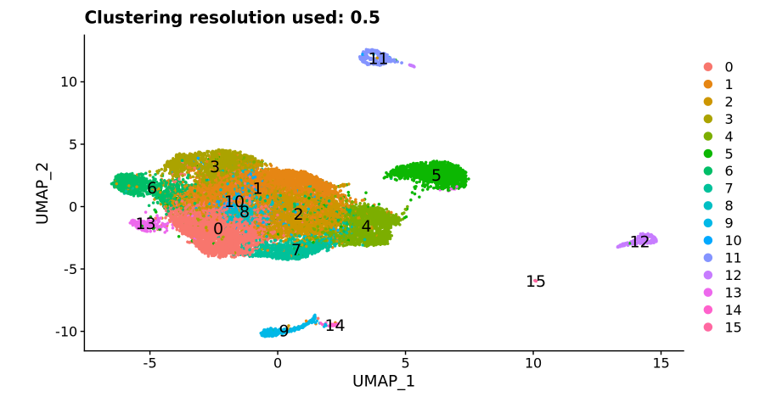
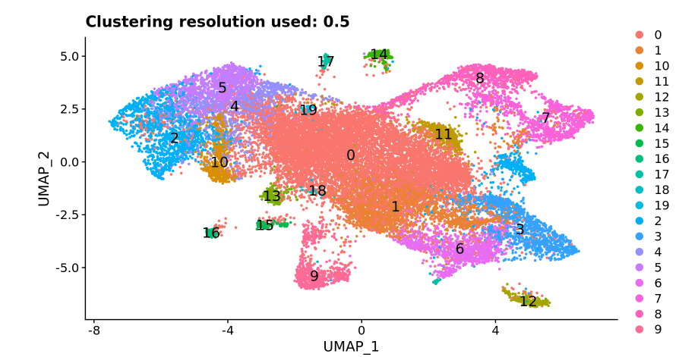
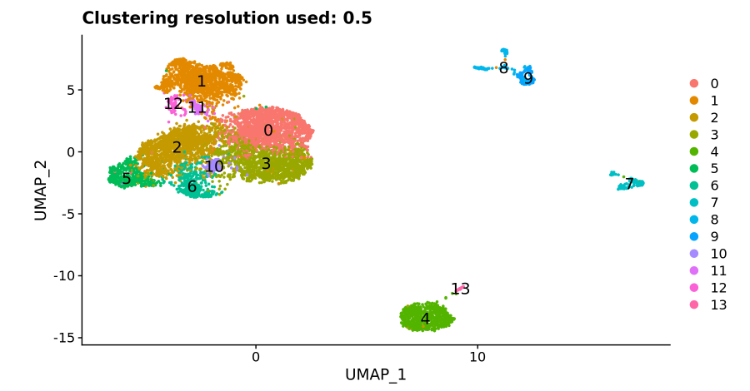
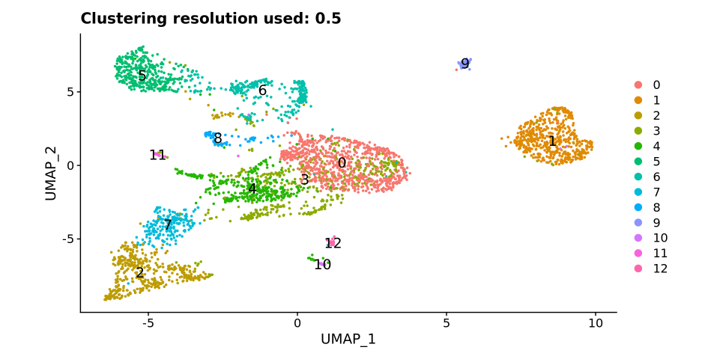
Overall Pattern
MIT
BGI
Complete
Control
Condition

Slide 44
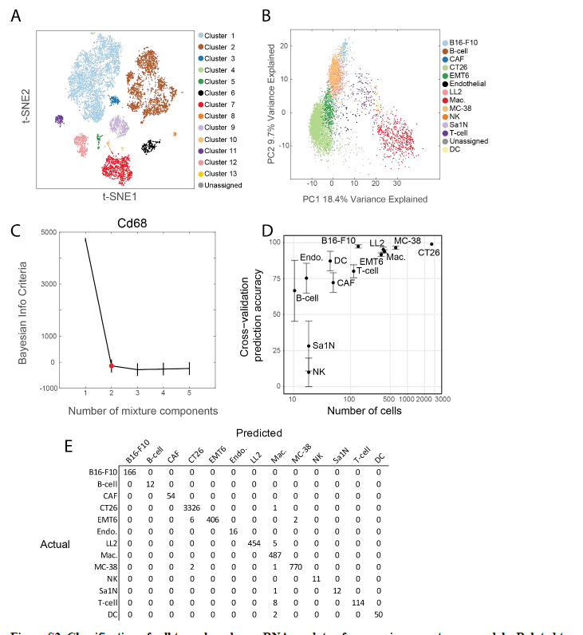
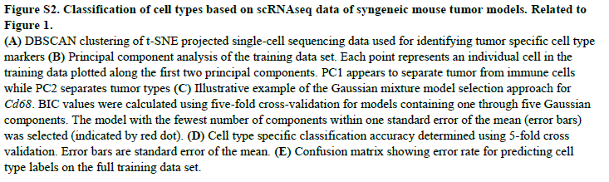

Slide 45
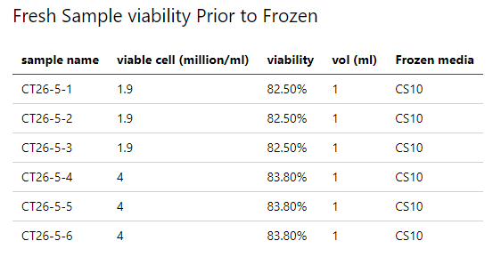
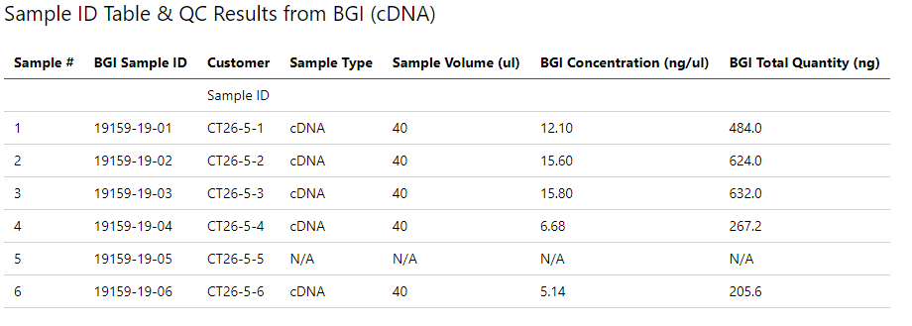
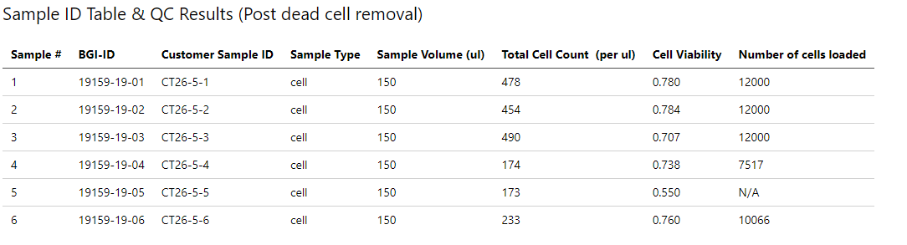
Sample Quality Control
Fresh Sample
had consistent viability
Sample 1-3: 1.9 million
Sample 4-6: 4 million
Library Preparation & QC
Quality and Cell Loading different between 1-3 vs 4-6
Cell Viability, inconsistent despite the consistent viability

Slide 46
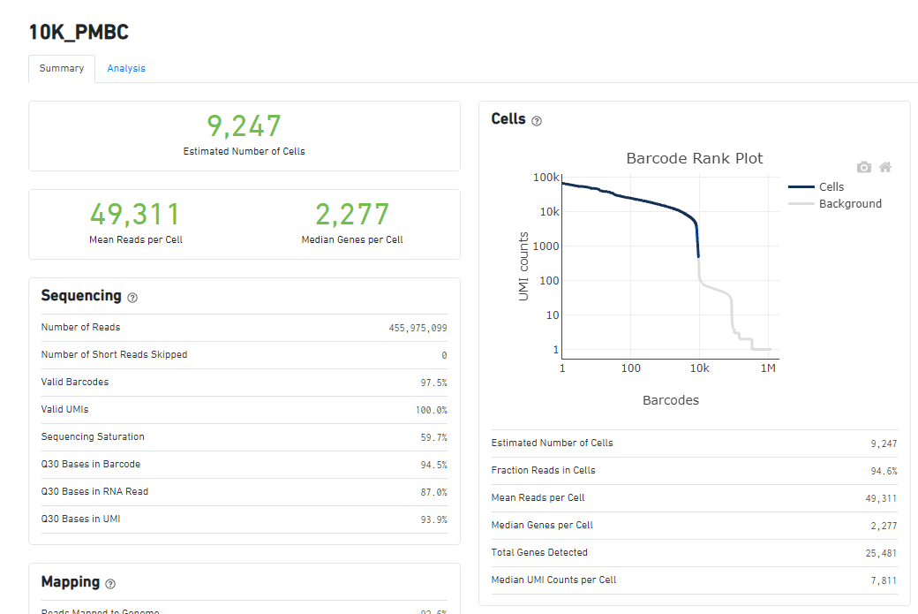
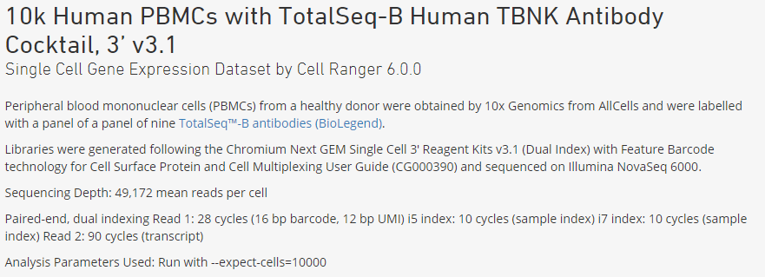
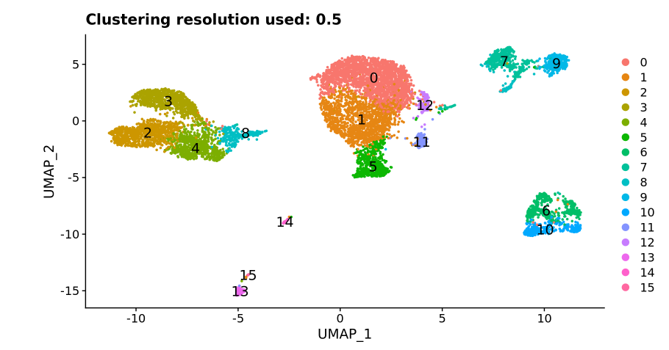
10k PMBC Results (Easy Biology & Example of clean scRNA-Seq)

Slide 47
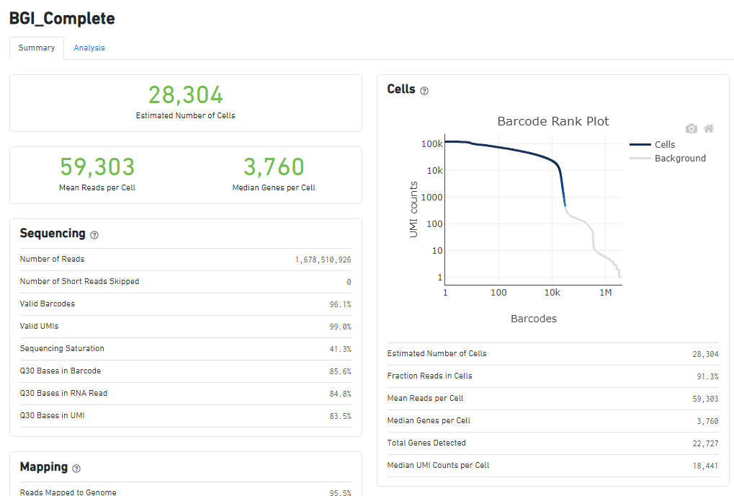
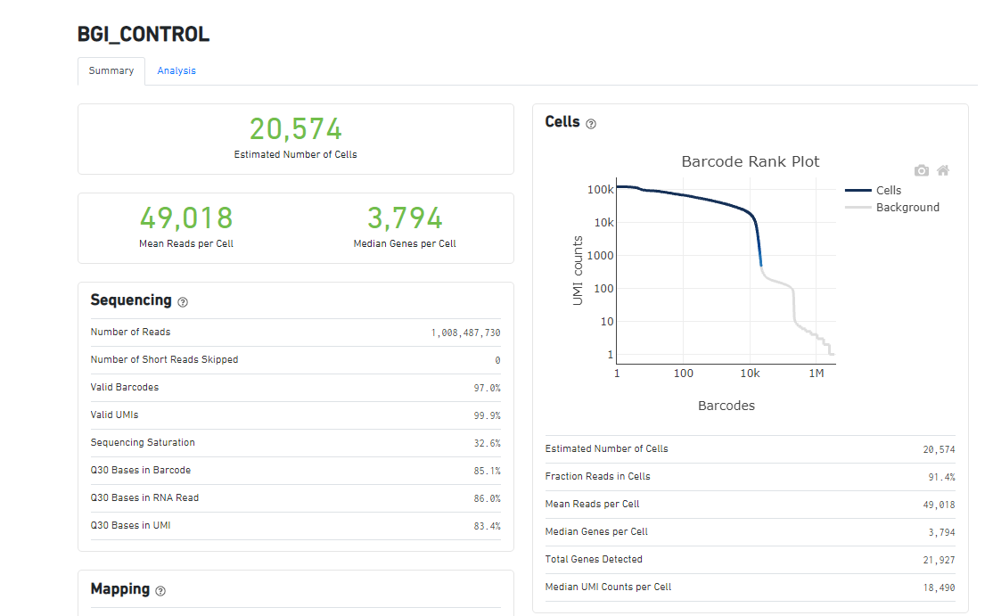




Overall Statistics

Slide 48


Distribution & Sampling Depth
BGI
MIT
Complete
Control
Condition

Slide 49
Overall Pattern
MIT
BGI
Complete
Control
Condition

Slide 50
Distribution & Sampling Depth
BGI
MIT
Complete
Control
Condition

Slide 51

scRNA-Seq NextFlow Workflow
Matrix Data
QC Plots
Cell Ranger
Lots of Extra Data: BAM etc.
PDF Report
k
QC_Filtering
Individual Plots from Report
Cell Type Calling

